Slide 1

Image courtesy of NASA/GSFC

Slide 2
Impact of Weather Extremes and Climate Change on Midwest Agriculture
Eugene S. Takle
Professor
Department of Agronomy
Department of Geological and Atmospheric Science
Director, Climate Science Program
Iowa State University
Ames, IA 50011
North American Millers Association
Division Meetings
Palm Coast, FL
25 March 2013

Slide 3
Outline
Recent trends in temperature and precipitation
Farmer adaptation to climate change
Projected long-term changes in US climate and grain producing regions
Drought development since end of 2012 and projections for summer 2013

Slide 4
Global CO₂ and Mean Temperature

Slide 5
Iowa State-Wide Average Data

Slide 6
Des Moines Airport Data
1983: 13
1988: 10
1977: 8
1974: 7

Slide 7
Des Moines Airport Data
1983: 13
1988: 10
1977: 8
1974: 7
6 days ≥ 100ºF in 23 years

Slide 8
Des Moines Airport Data
1983: 13
11 days in 2012
1988: 10
1977: 8
1974: 7
6 days ≥ 100ºF in 23 years

Slide 11
Iowa State-Wide Average Data
2012

Slide 12
Iowa State-Wide Average Data
Totals above 40”
3 years
5 years
2012

Slide 13
Iowa State-Wide Average Data
Totals above 40”
3 years
5 years
2012
1990-2011 highly favorable precip for crops

Slide 14
Cedar Rapids, Iowa Data

Slide 15
Cedar Rapids, Iowa Data
28.0”
39% increase
39.0”

Slide 16
Cedar Rapids, Iowa Data
Years with more than 40 inches
18
2

Slide 17
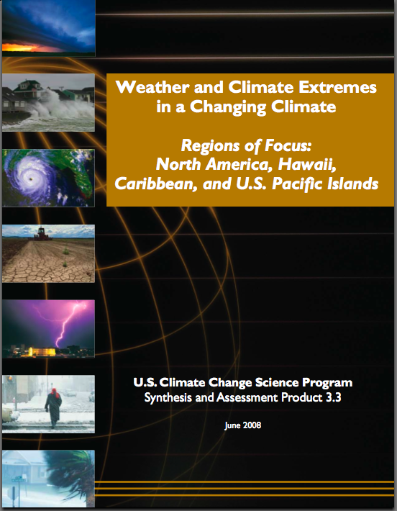
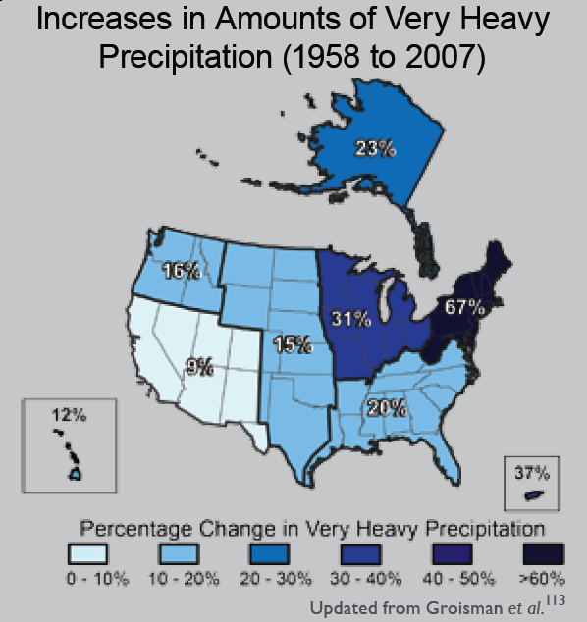
“One of the clearest trends in the United States observational record is an increasing frequency and intensity of heavy precipitation events… Over the last century there was a 50% increase in the frequency of days with precipitation over 101.6 mm (four inches) in the upper midwestern U.S.; this trend is statistically significant “
Karl, T. R., J. M. Melillo, and T. C. Peterson, (eds.), 2009: Global Climate Change Impacts in the United States. Cambridge University Press, 2009, 196pp.

Slide 18
Cedar Rapids, Iowa Data

Slide 19
Cedar Rapids, Iowa Data
Creates runoff

Slide 20
Cedar Rapids, Iowa Data
3.6 days
69% increase
6.1 days

Slide 21
Cedar Rapids, Iowa Data
Number of Years with More than 8 Occurrences
0
9

Slide 22
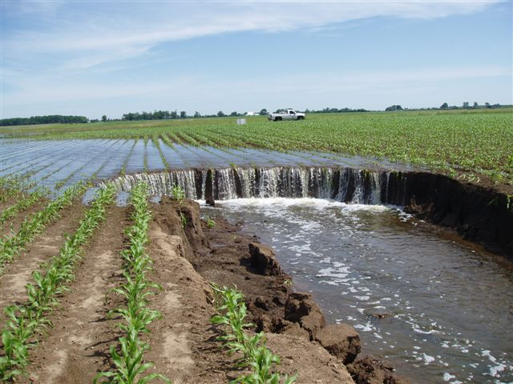
Photo courtesy of RM Cruse

Slide 24
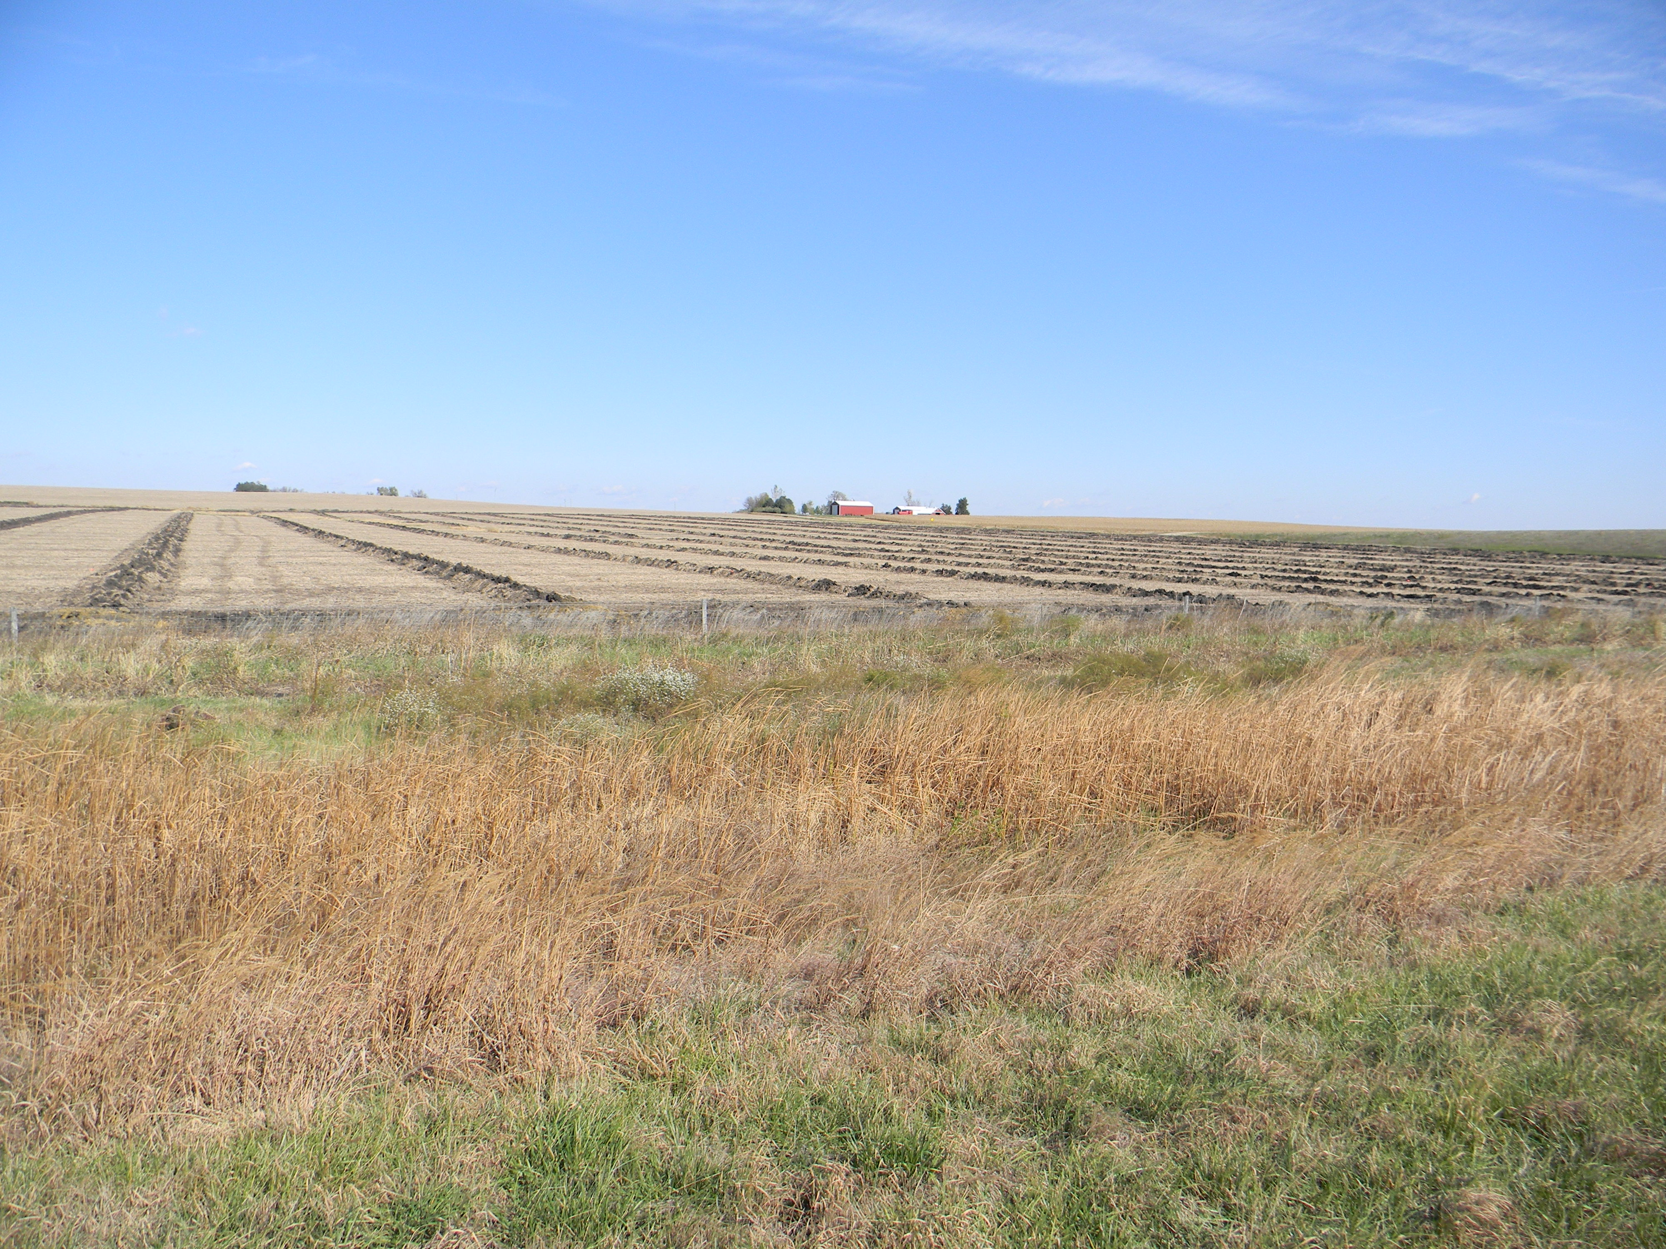

Slide 25
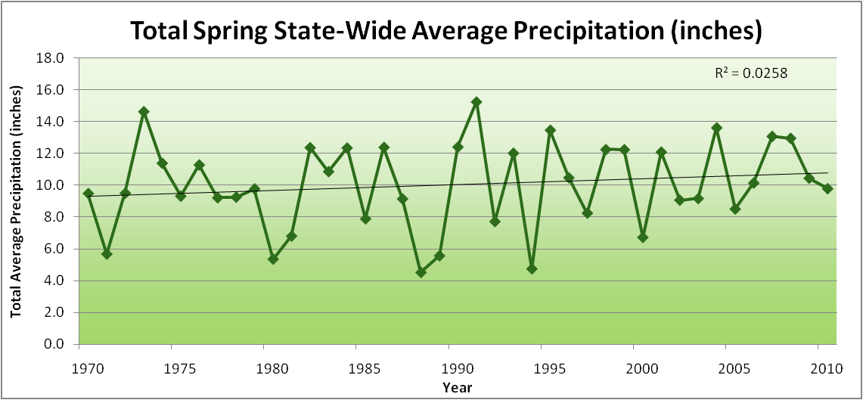
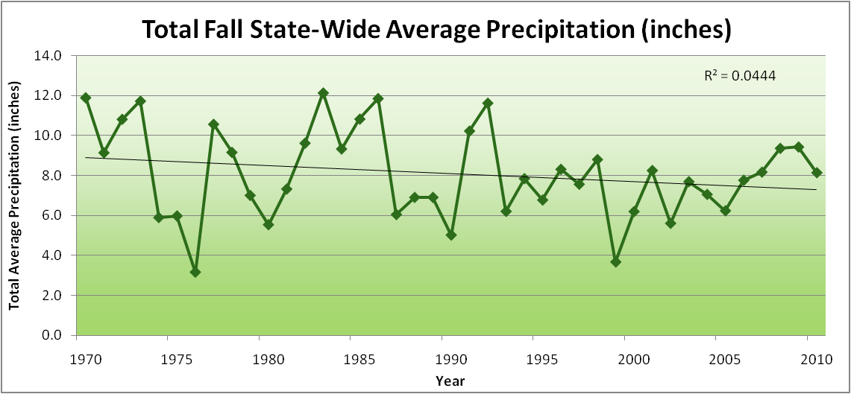
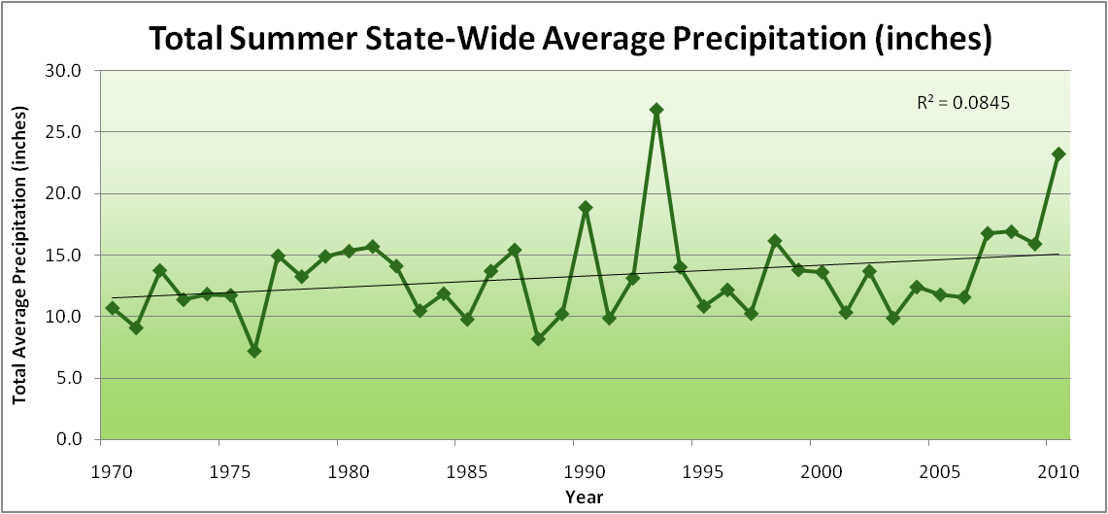
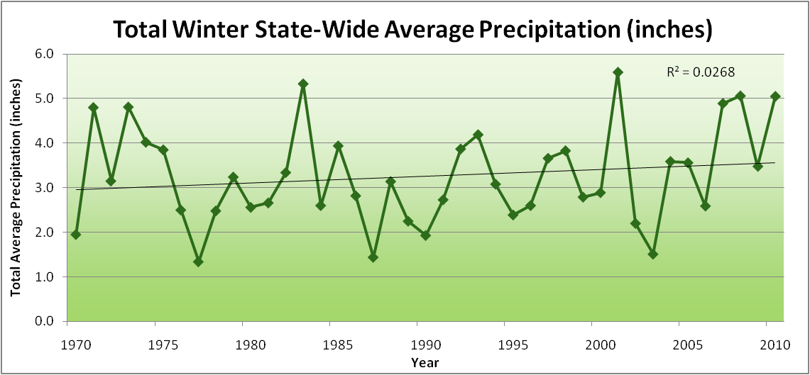
Amplification of the Seasonality of Precipitation
Spring
Fall
Summer
Winter

Slide 26
Amplification of the Seasonality of Precipitation
Spring
Fall
Summer
Winter

Slide 27
Amplification of the Seasonality of Precipitation
Spring
Fall
21.2 => 25.3 inches (22% increase)
12.1 => 10.5 inches (13% decrease)
Summer
Winter

Slide 28
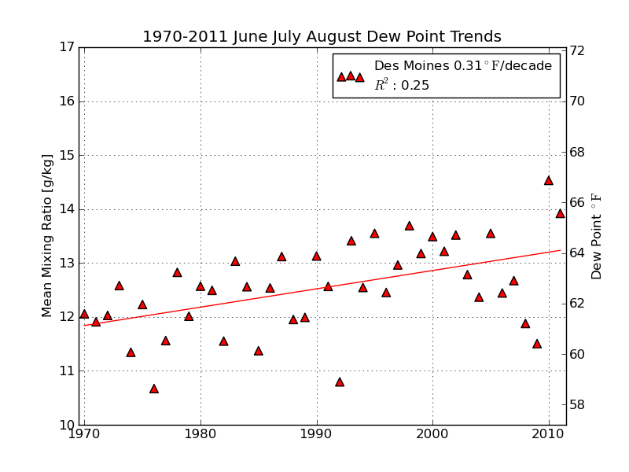
Mean Summer (JJA) Dew-Point Temperatures for Des Moines, IA
Rise of 3ºF in 42 years
12% rise in water content in 42 years

Slide 29
Iowa Agricultural Producers are Adapting to Climate Change:
Longer growing season: plant earlier, plant longer season hybrids, harvest later
Wetter springs: larger machinery enables planting in smaller weather windows
More summer precipitation: higher planting densities for higher yields
Wetter springs and summers: more subsurface drainage tile is being installed, closer spacing, sloped surfaces
Fewer extreme heat events: higher planting densities, fewer pollination failures; and planting seeds with a variety of pollination periods
Higher humidity: more spraying for pathogens favored by moist conditions. more problems with fall crop dry-down, wider bean heads for faster harvest due to shorter harvest period during the daytime.
Drier autumns: delay harvest to take advantage of natural dry-down conditions, thereby reducing fuel costs
HIGHER YIELDS!!
Is it genetics or climate? Likely some of each.

Slide 30
So what about climates of the future?

Slide 31
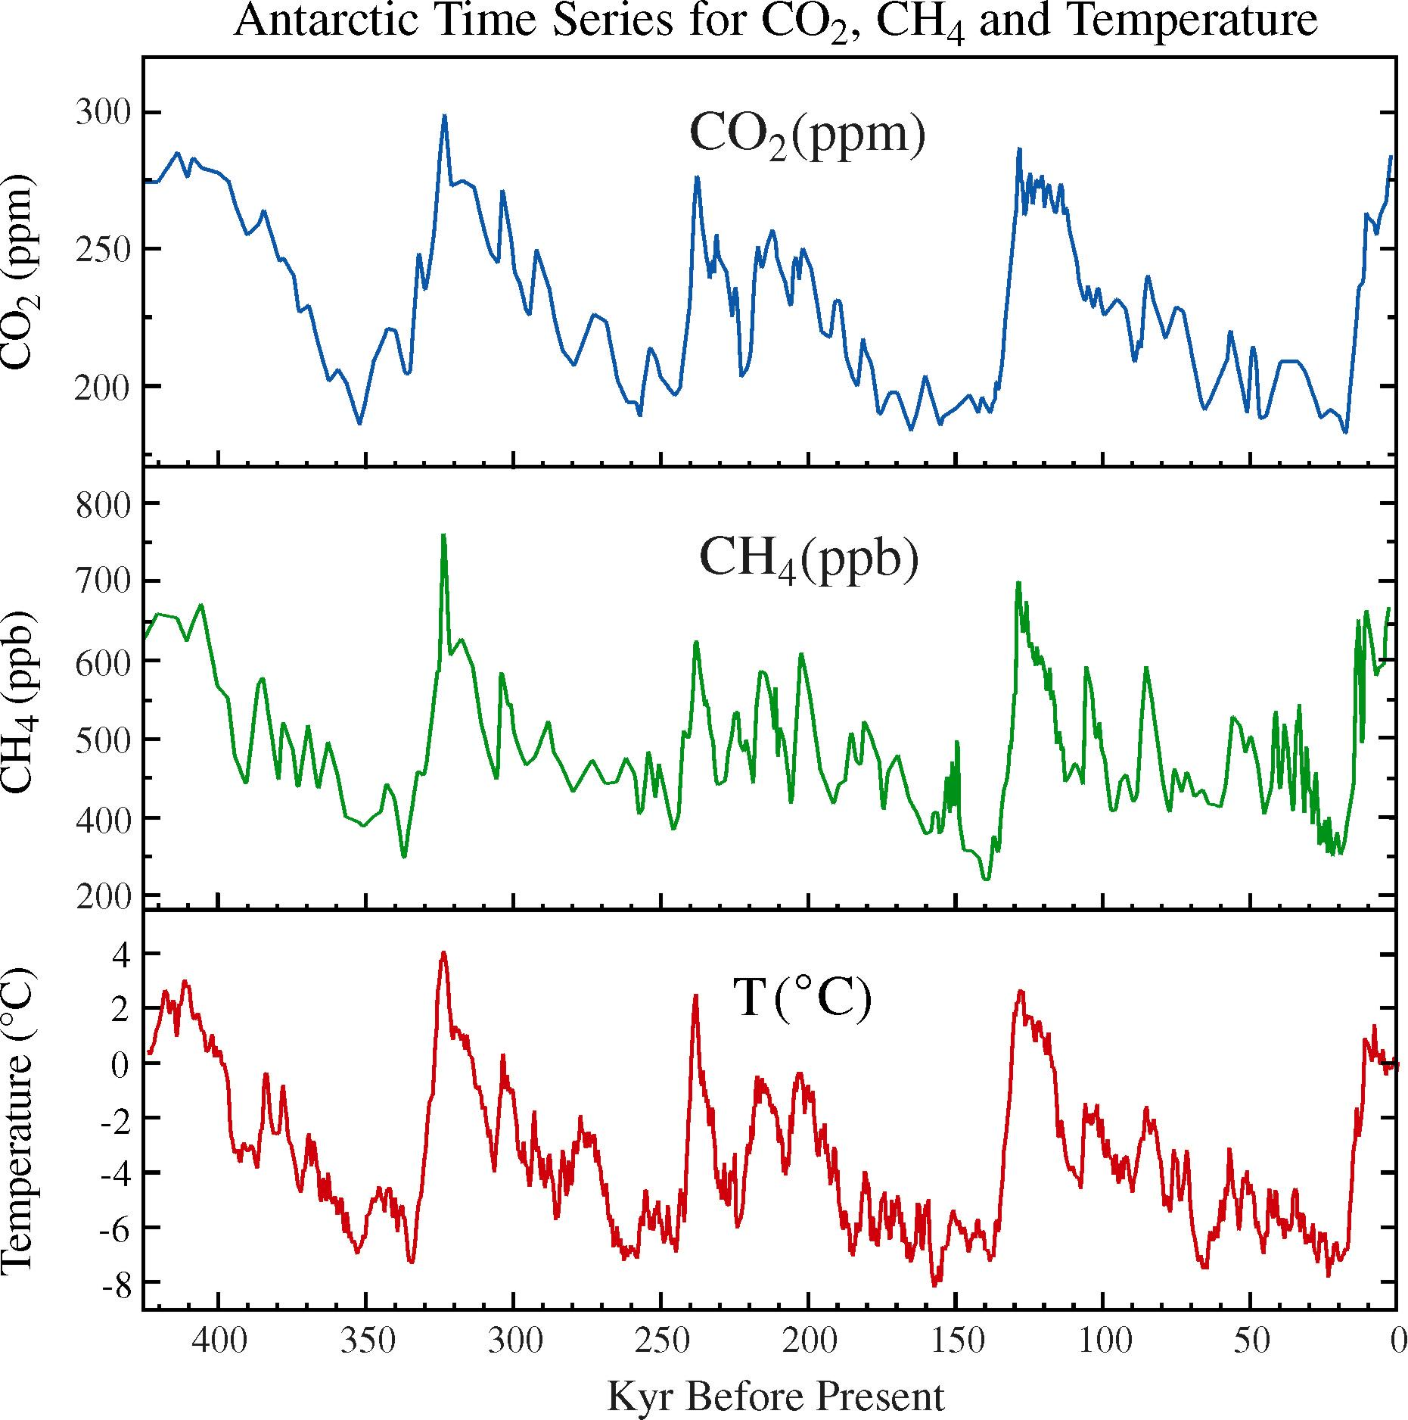
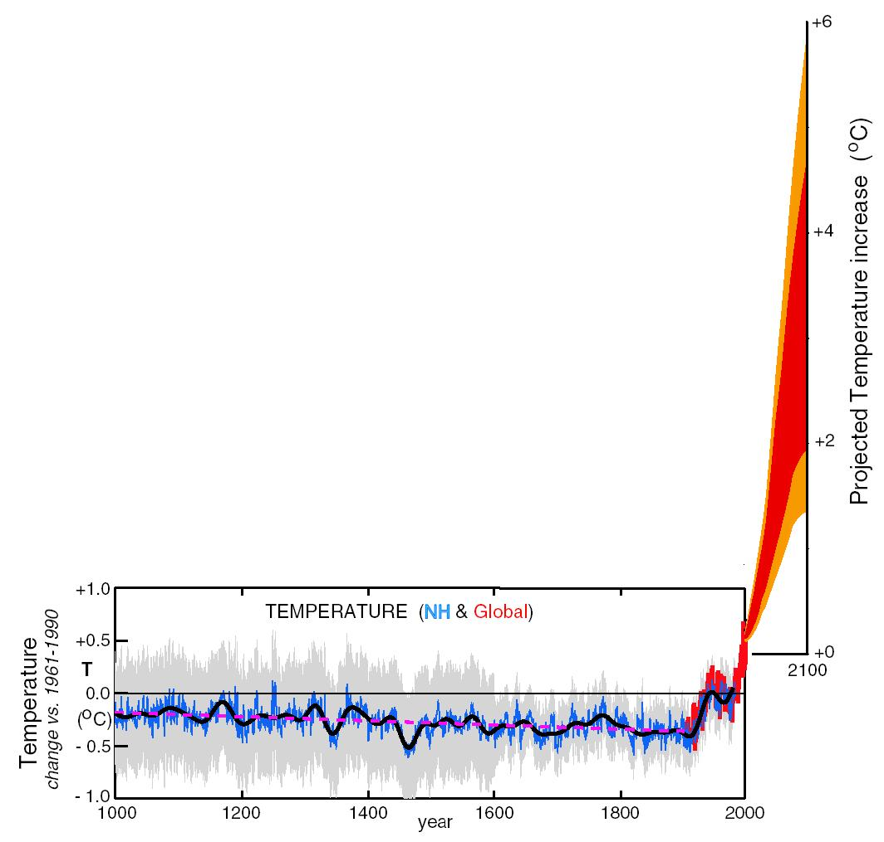
What can we expect in the future?
Don Wuebbles

Slide 32
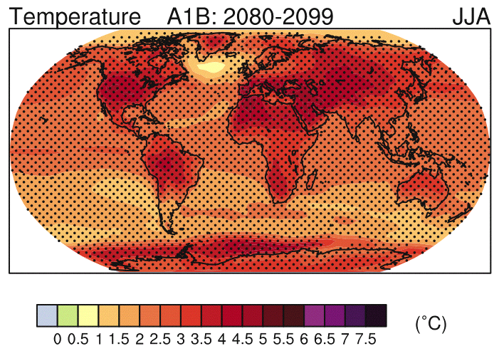
IPCC 2007

Slide 33
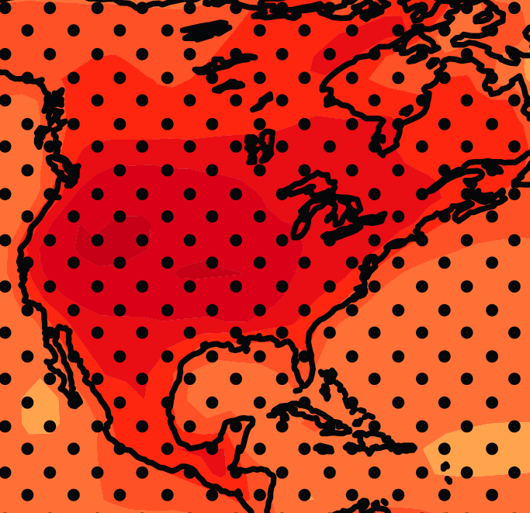
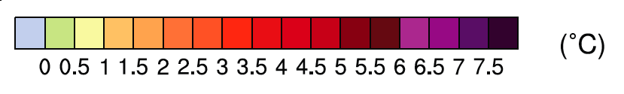
June-July-August Temperature Change
4.5ºF
5.4ºF
A1B Emission Scenario
2080-2099 minus1980-1999

Slide 34
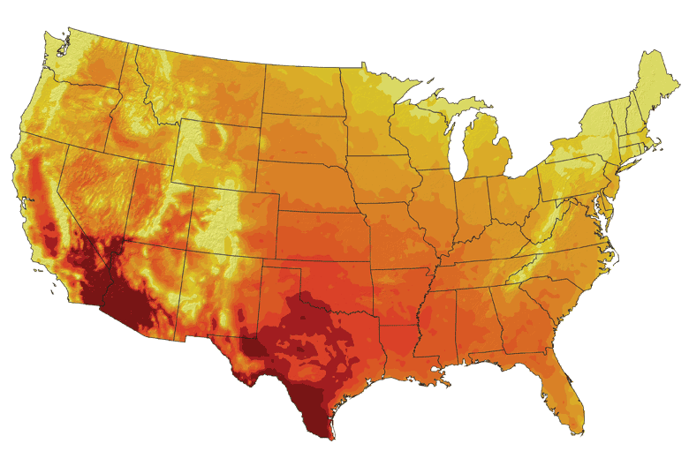
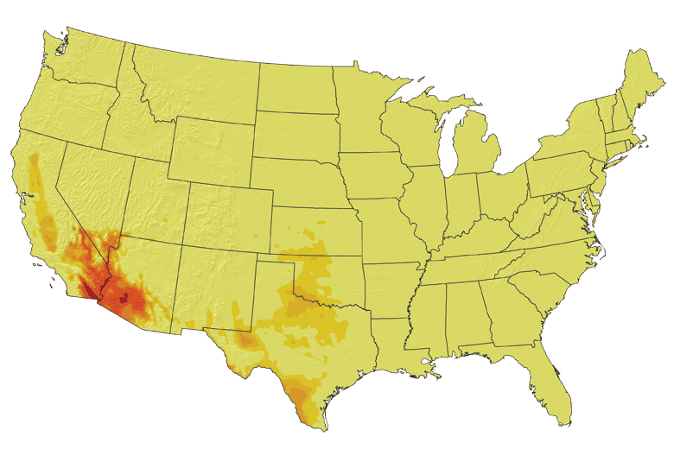
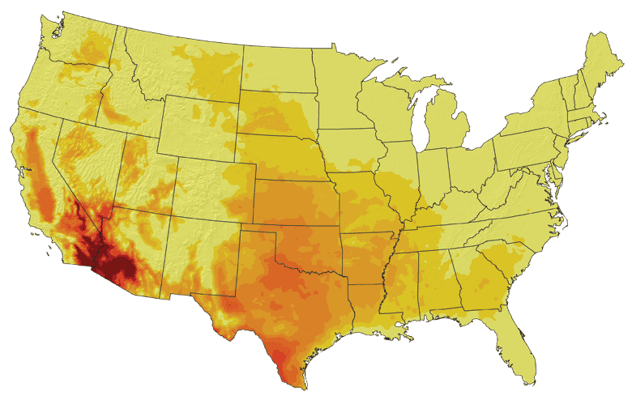
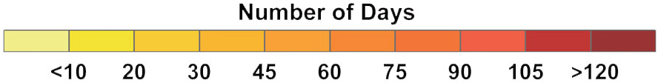
Increases in very high temperatures will have
wide-ranging effects
Higher Emissions Scenario, 2080-2099
Number of Days Over 100ºF
Recent Past, 1961-1979
Average:
30-60 days
Lower Emissions Scenario, 2080-2099
Average:
10-20 days
Don Wuebbles

Slide 35
Increases in very high temperatures will have
wide-ranging effects
Higher Emissions Scenario, 2080-2099
Number of Days Over 100ºF
Recent Past, 1961-1979
Average:
30-60 days
Current Des Moines average is < 1.4 days per year over 100ºF
Lower Emissions Scenario, 2080-2099
Average:
10-20 days
Don Wuebbles

Slide 36
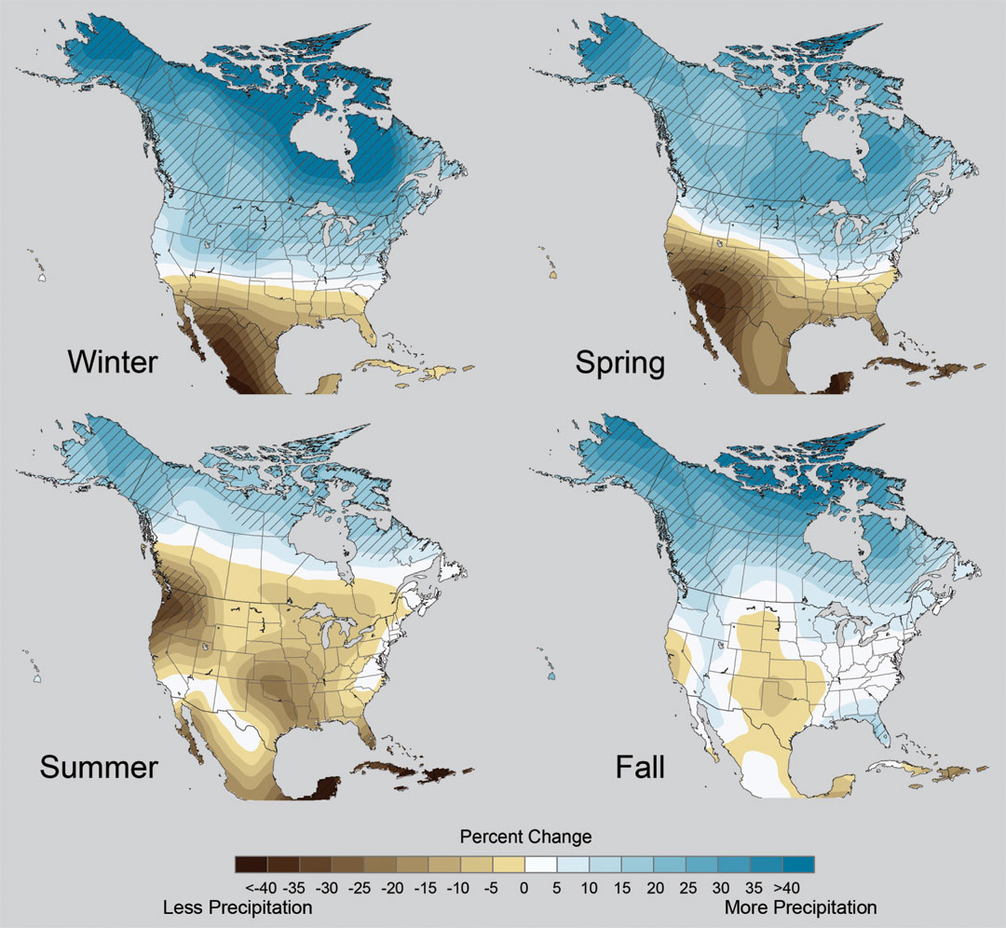
Projected Change in Precipitation: 2081-2099
Midwest: Increasing winter and spring precipitation, with drier summers
More frequent and intense periods of heavy rainfall
Unstippled regions indicate reduced confidence
CAUTION: High uncertainty
Relative to 1960-1990
NOTE: Scale Reversed

Slide 37
Extreme weather events become more common
Events now considered rare will become commonplace.
Heat waves will likely become longer and more severe
Droughts are likely to become more frequent and severe in some regions
Likely increase in severe thunderstorms (and perhaps in tornadoes).
Winter storm tracks are shifting northward and the strongest storms are likely to become stronger and more frequent.
Don Wuebbles
Notes:
Shown here is the frequency at the end of the century of what we consider now to be a 20 year heat wave. Instead of once every 20 years, these temperatures would be experienced every other year or so over most of the continental US in this business as usual scenario.

Slide 38
Percent Changes in Crop Yield with
Projected Changes in Annual Mean Temperature
(not water or nutrient limited)
California Central Valley
Lee, J., S. DeGryze, and J. Six. 2011. Effect of climate change on field crop production in the California’s Central Valley. Climatic Change. 109(Suppl):S335-S353

Slide 39
Length of Grain Fill Period and Corn Yields: Impact of High Temperatures
Illinois
High nighttime temperatures reduce length of grain fill period
Indiana
The Climate Corporation (http://www.climate.com/2012outlook/nighttime-heat-stress)
Illinois
High nighttime temperatures during grain fill period reduce yields
Indiana

Slide 40
Iowa State-Wide Average Data
Totals above 40”
3 years
5 years
2012

Slide 41
Iowa State-Wide Average Data
Totals above 40”
3 years
5 years
5 years
7 years
2012
Totals below 25”

Slide 42
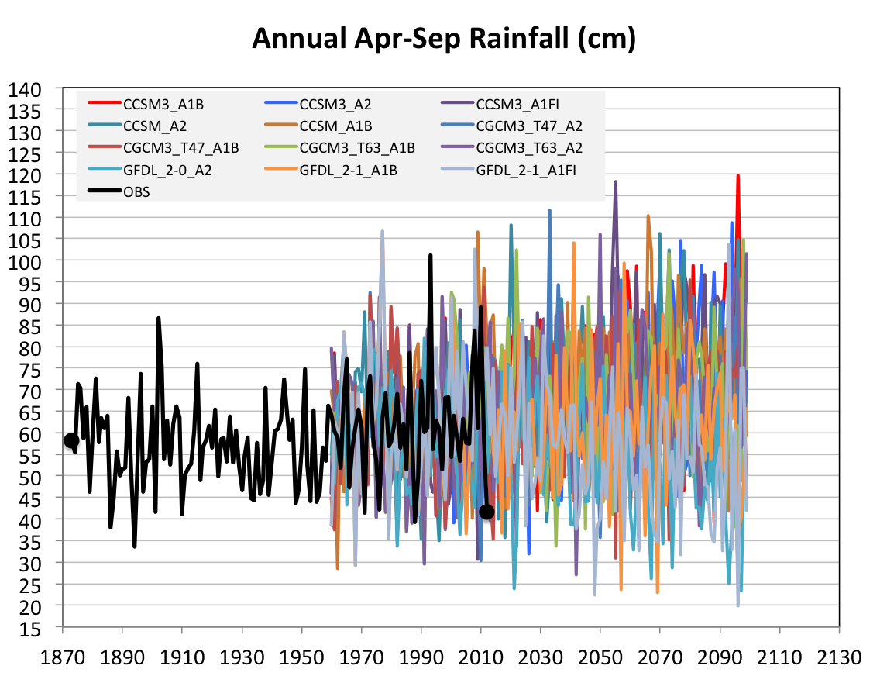
Projected Future Variability in Growing Season Precipitation for Iowa
More extreme high precip years
More extreme low precip years
CJ Anderson, ISU

Slide 43
Future Variability in Growing Season Precipitation for Iowa
More extreme high precip years
Lines drawn by eye
More extreme low precip years
CJ Anderson, ISU

Slide 44
Yield Change by Mid-Century:
Maize
Takle, E. S., D. Gustafson, R. Beachy, G. C. Nelson, D. Mason-D’Croz, and A. Palazzo (2013). US Food Security and Climate Change: Agricultural Futures. Economics Discussion Papers, No 2013-17, Kiel Institute for the World Economy. http://www.economics-ejournal.org/economics/discussionpapers/2013-17

Slide 45
Yield Change by Mid-Century:
Soybeans
Takle, E. S., D. Gustafson, R. Beachy, G. C. Nelson, D. Mason-D’Croz, and A. Palazzo (2013). US Food Security and Climate Change: Agricultural Futures. Economics Discussion Papers, No 2013-17, Kiel Institute for the World Economy. http://www.economics-ejournal.org/economics/discussionpapers/2013-17

Slide 46
Yield Change by Mid-Century:
Wheat
Takle, E. S., D. Gustafson, R. Beachy, G. C. Nelson, D. Mason-D’Croz, and A. Palazzo (2013). US Food Security and Climate Change: Agricultural Futures. Economics Discussion Papers, No 2013-17, Kiel Institute for the World Economy. http://www.economics-ejournal.org/economics/discussionpapers/2013-17

Slide 47
What about 2013?
Drought Development from 2012

Slide 48
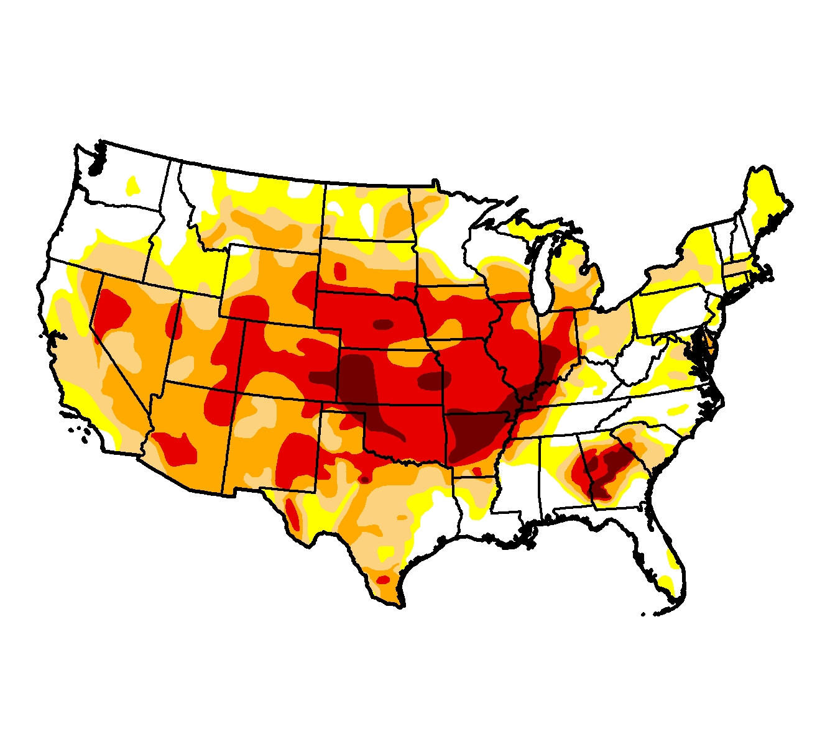
7 August 2012
http://droughtmonitor.unl.edu/

Slide 49
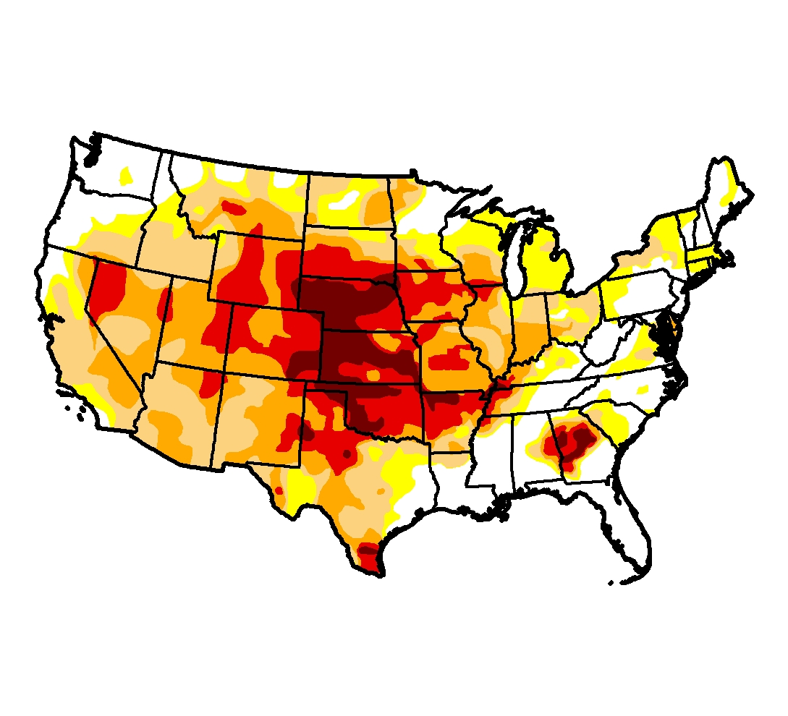
4 September 2012
http://droughtmonitor.unl.edu/

Slide 50
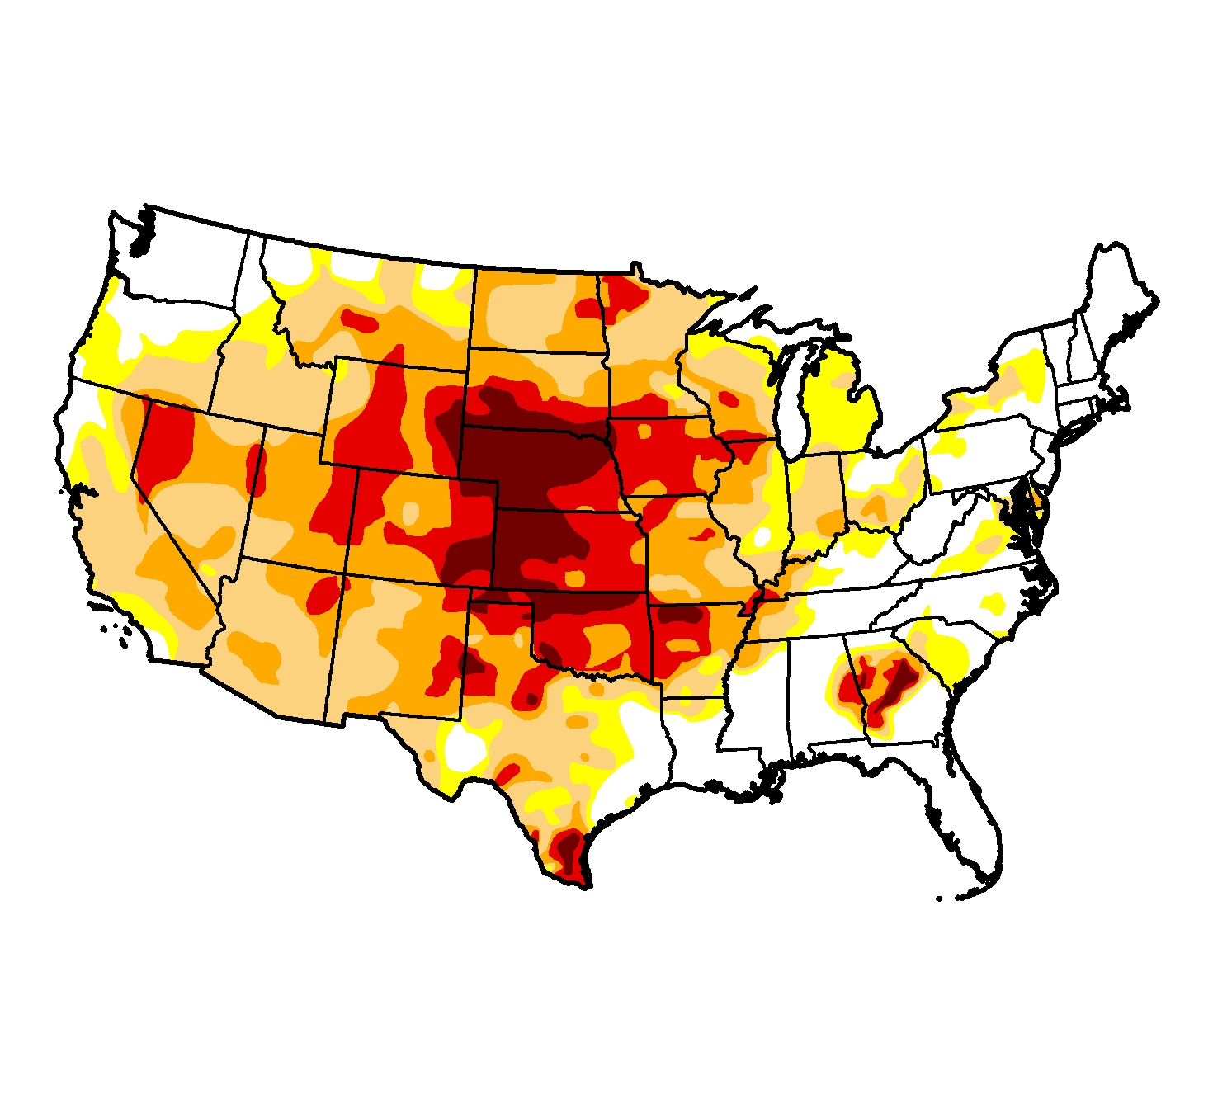
2 October 2012
http://droughtmonitor.unl.edu/

Slide 51
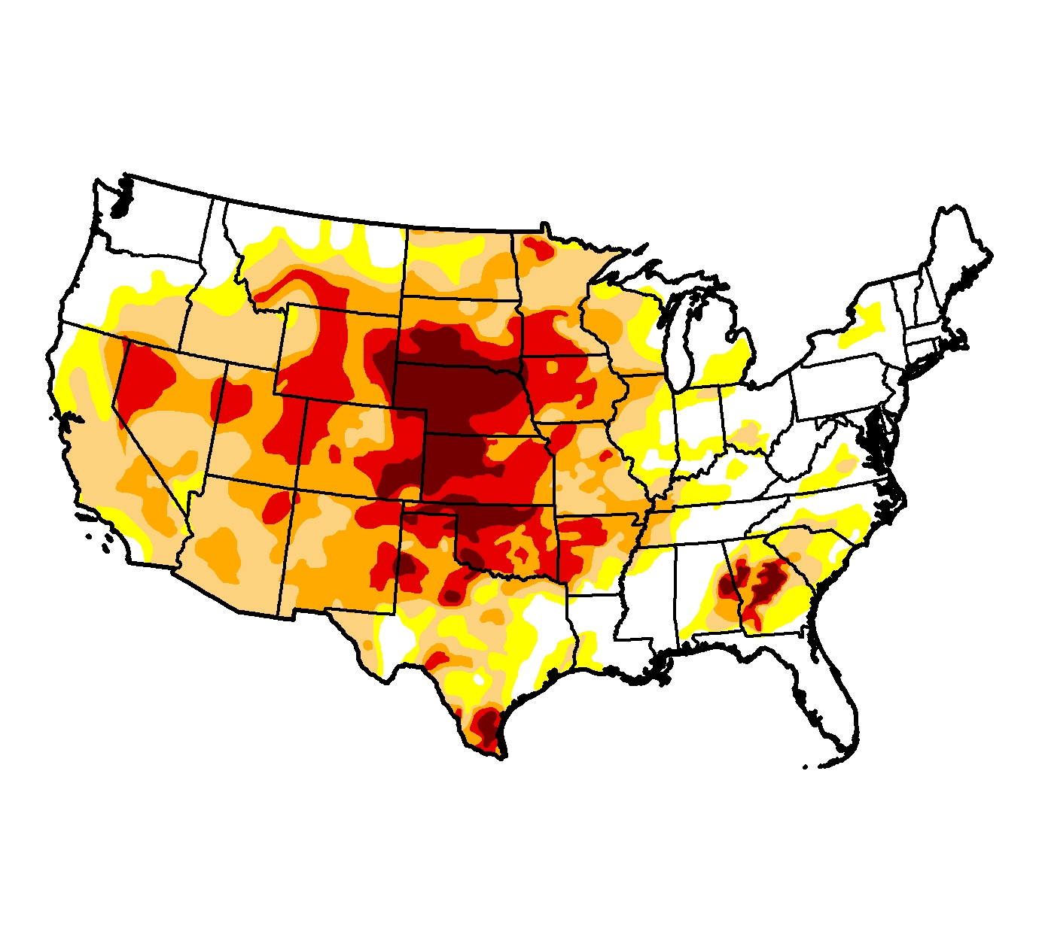
6 November 2012
http://droughtmonitor.unl.edu/

Slide 52
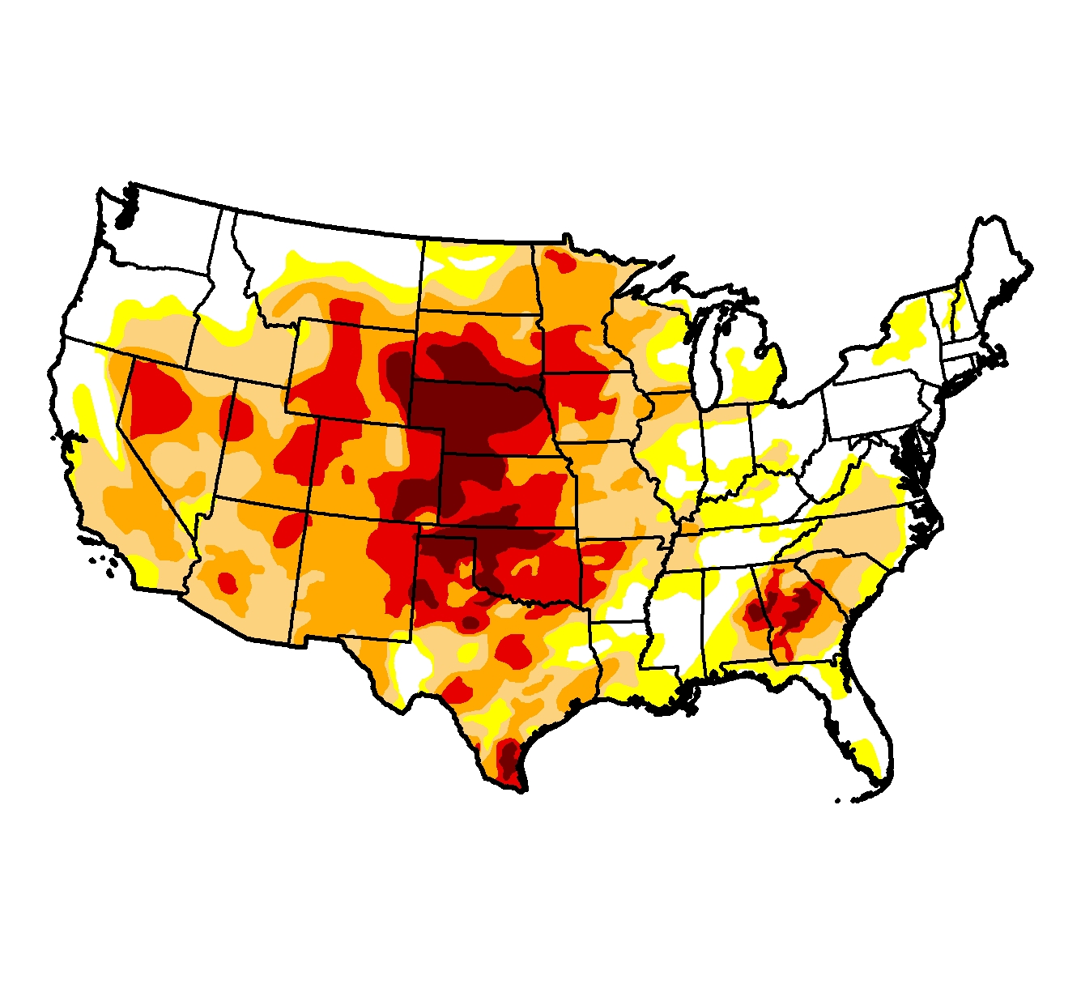
4 December 2012
http://droughtmonitor.unl.edu/

Slide 53
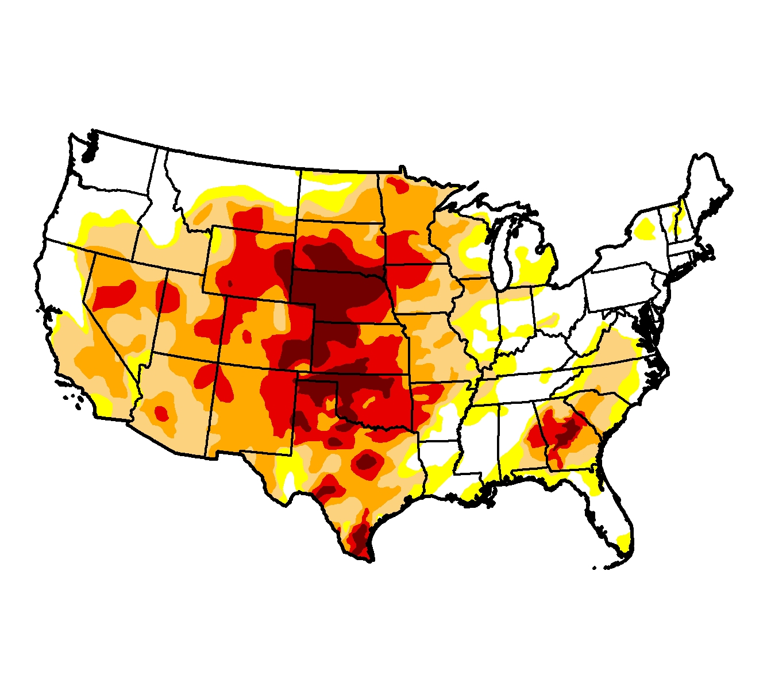
1 January 2012
http://droughtmonitor.unl.edu/

Slide 54
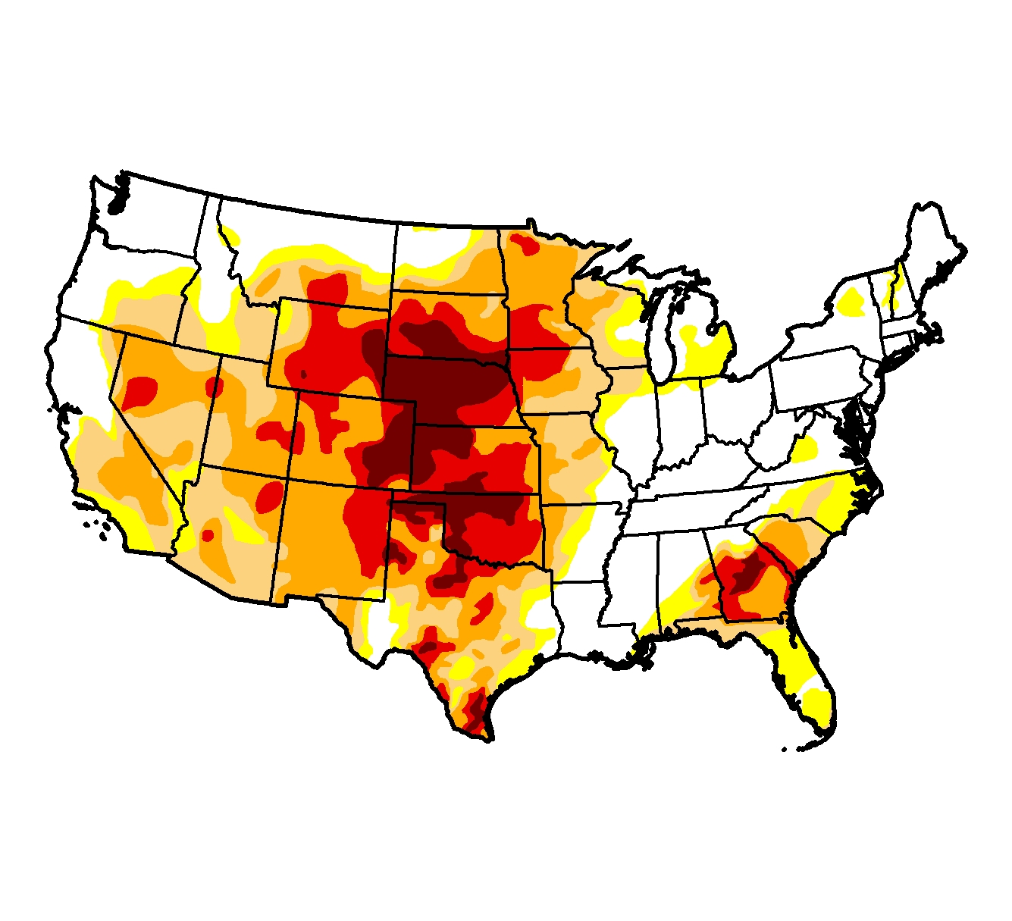
5 February 2012
http://droughtmonitor.unl.edu/

Slide 55
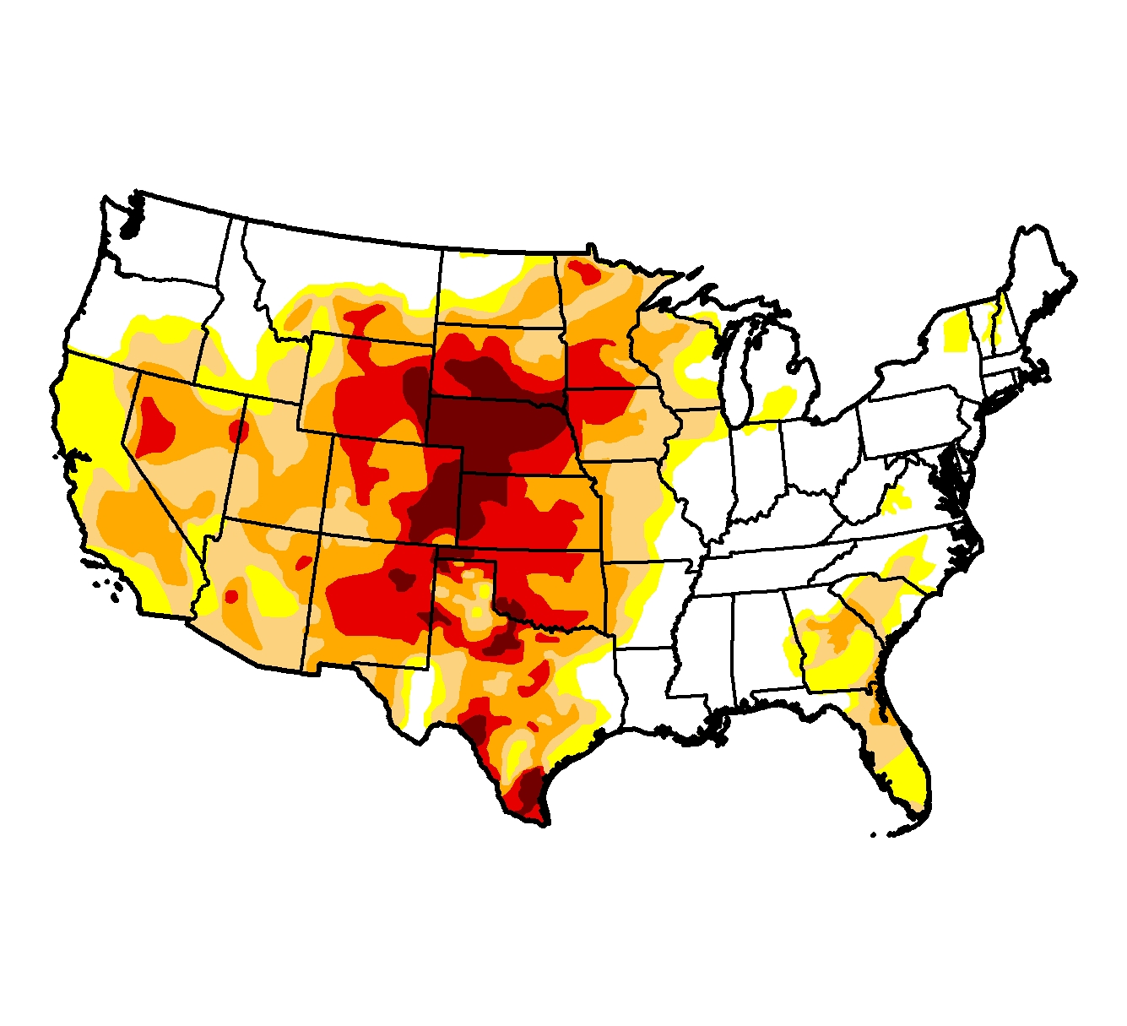
5 March 2012
http://droughtmonitor.unl.edu/

Slide 56
What about 2013?
Looking Forward
Dr. Pat Guinan
Extension/State Climatologist
University of Missouri
guinanp@missouri.edu
http://mrcc.isws.illinois.edu/webinars.htm
21 March 2013

Slide 57
Guinan

Slide 58
Guinan

Slide 59
Guinan

Slide 60
Guinan

Slide 61
Guinan

Slide 62
Guinan

Slide 63
Future Projections
Guinan

Slide 64
Future Projections
Guinan

Slide 65
Future Projections
Guinan

Slide 66
Future Projections
Guinan

Slide 67
Summary
The climate in the Midwest has changed over the last 40 years
Farmers so far have been able to adapt and maintain high production
Frequency of precipitation extremes has increased and very likely will continue to increase
Drought intensity has diminished in the east but remains in the west

Slide 68
For More Information:
Climate Science Program
Iowa State University
http://climate.engineering.iastate.edu/
http://www.meteor.iastate.edu/faculty/takle/
gstakle@iastate.edu

